Slide 1


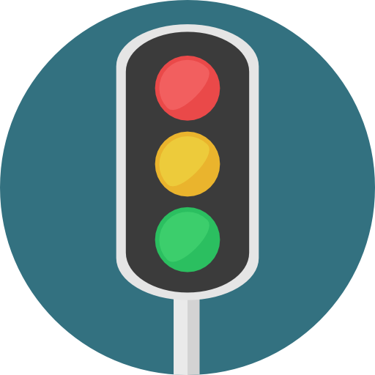
Institute Of Technology Of CambodIA LECTURER: HENG RATHPISEY
Subject: Combinational and Sequential Logics Sequential circuit Mini project: Traffic Light
1

Slide 2
GRUOUP I3-GIC-C YEAR 2021-2022 TEAM 04
MEMBER ID
SDEUN VIRAKNON E20190961
TY CHHENGLONG E20191217
TOUN DINA E20191207
VEN THON E20191250
2

Slide 3

CONTENT
Introduction
Objective of project
Component overviews of system
Implementation
Component build counter
Component create Ring counter
Component create controller
Combine
Result
Successful features
EXPERIENCE
3

Slide 4

Introduction
Objective of project
This report is an overview of our project which is about the combinational and sequential logics function. The goal of this project is to design and control system of traffic light. For simple system of this project and initializer to able to do it are:
To build counter down
To create circuit using true table
To create function of traffic light
To create ring counter
To create controller
4

Slide 5
Introduction
2.Component overviews of system
Logic gates ( nor gate, or gate, and gate, xor gate)
Input ( input, button, power, constant value)
Output ( output, digital led, hex display)
Decoder & Plexers ( demultiplexer, decoder)
Sequential element ( D flip flop, JK flip flop, clock)
Annotation ( text)
Mise ( splitter)
5

Slide 6
Implementation
1.Component build counter
For to build counter this project are 5 counter:
Counter down 9 to 0
Use JK flip flop 4 bit decade counter exhibits a truncated binary sequence and goes from 0000 through the start 1001 state. Rather than going from 1001 state to the 0001, it recycles to the 0000 state.
Counter down 5 to 0
Use JK flip flop 3 bit decade counter exhibits a truncated binary sequence and goes from 0000 through the start 0101 state. Rather than going from 0101 state to the 0001, it recycles to the 0000 state.
Counter down 1 to 0
Use JK flip flop 1 bit decade counter exhibits to binary sequence start 0001, it recycle to the 0000.
6

Slide 7
Counter down 59 to 0
Use counter down 5 to 0 combination with counter down 9 to 0, result count number 59 to 0 .
Counter down 99 to 0
Use counter down 9 to 0 with counter down 9 to 0 and result got count number 99 to 0 .
7

Slide 8
2. Component create ring counter
We used D flip flop 6 bits to make ring counter to be connect with controller.
3. Component create controller
We used true table and 6 input to set of traffic signs.
4. Combine
We connect decoder and clock with counter down 99 to 0, 59 to 0, 5 to 0 and 1 to 0. And then connect to multiplexer with ring counter and controller to be set of traffic signs.
8

Slide 9
III. Result
1. Successful features
In this project, we have completed all the features successfully.
2. Experience
In conclusion, all the member worked hard on this project. So that all member shared their knowledge and some information to the team and combined the ideas together. Upon completion of this project, one will be able to understand how to use some components in combinational circuit and know how to build sequence circuit properly. Moreover, we also learned about JK flip flop, counters, and true table. Furthermore, we could get a lot of experiences about my team work.
9

Slide 10
Thank you!
10

